Slide 1
Employee Attrition

Slide 2
Introduction
Employee attrition, also known as employee turnover, is the rate at which employees leave a company and are replaced by new hires. Understanding and managing attrition is crucial for maintaining a stable and productive workforce.
As an HR professional, managing employee attrition is a critical responsibility that involves several key activities. Firstly, data collection and analysis are fundamental; leveraging tools like Power BI helps visualize attrition trends and identify critical areas of concern.
Recognizing patterns in turnover by department or role allows HR to develop targeted retention strategies.

Slide 3
Details of Data
Employee_ID: Unique identifier for each employee
Age: Age of the employee
Attrition: Whether the employee has left the company (Yes/No)
Business_Travel: Frequency of business travel
Department: Department of the employee
Distance_FromHome: Distance from home to work
Education: Education level
Education_Field: Field of education
Employee_Count: Number of employees (all values are 1)
Gender: Gender of the employee
TrainingTimesLastYear: Number of training sessions attended last year
YearsAtCompany: Number of years at the company
YearsSinceLastPromotion: Number of years since the last promotion
YearsWithCurrManager: Number of years with the current manager
EnvironmentSatisfaction: Satisfaction with the work environment

Slide 4
Main KPIs
Overall Attrition Rate
Attrition by Department and role
Attrition by Age Group
Attrition by Gender
Attrition by Education Level
Tenure Analysis

Slide 5
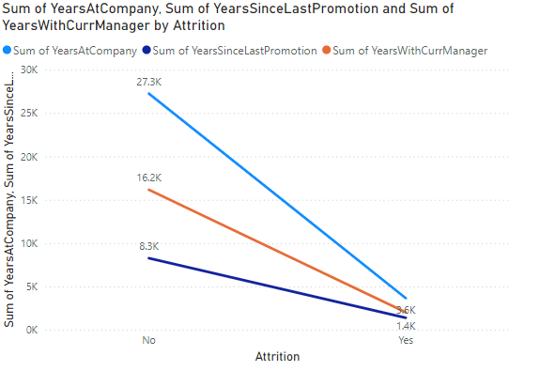
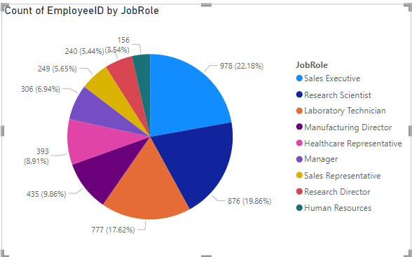
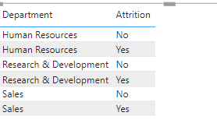
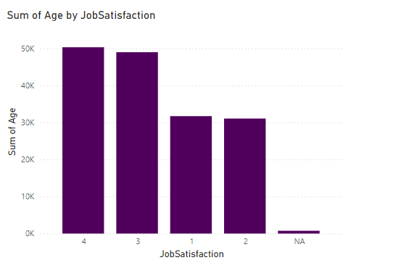
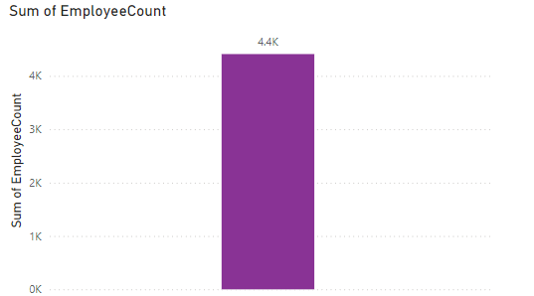
Mock-up Dashboard

Slide 6
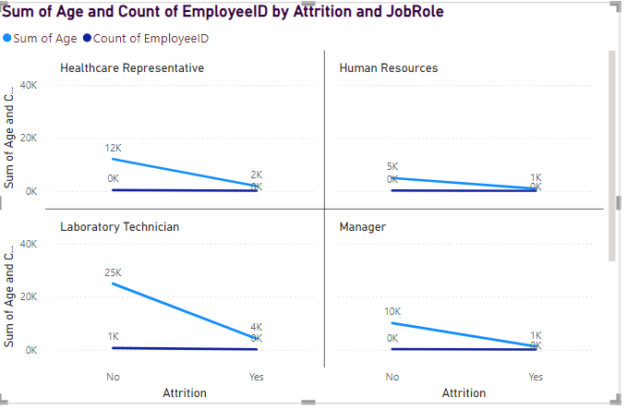
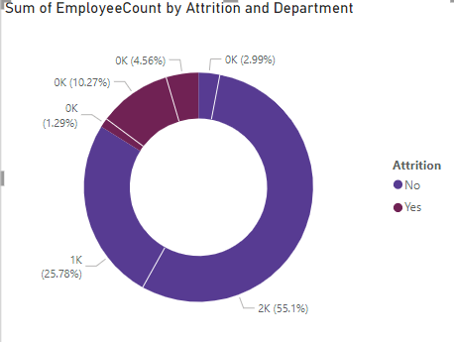
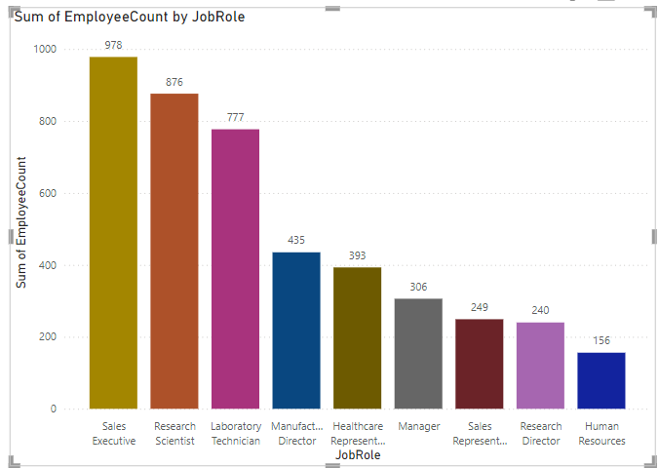
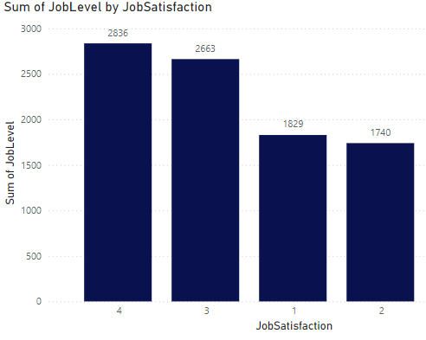
Dashboard

Slide 7


